Slide 1
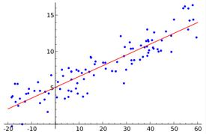
How to find the law behind the real-world data which are usually corrupted by noise or error？

Slide 2
the semi-major axis of each planet outward from the Sun in units such that the Earth's semi-major axis is equal to 1.
(4+0)/10=0.4 (Mercury)；
(4+3)/10=0.7 (Venus)；
(4+6)/10=1.0 (Earth)；
(4+12)/10=1.6 (Mars)；
(4+48)/10=5.2 (Jupiter)；
(4+96)/10=10 (Saturn)；

Slide 3
Titius-Bode Law (3*2ⁿ+4)/10
(4+0)/10=0.4 (Mercury)；
(4+3*2⁰)/10=0.7 (Venus)；
(4+3*2¹)/10=1.0；
(4+3*2²)/10=1.6 (Mars)；
(4+3*2³)/10=2.8 (?)；
(4+3*2⁴)/10=5.2 (Jupiter)；
(4+3*2⁵)/10=10 (Saturn)；
(4+3*2⁶)/10=19.6 (？)；

Slide 4
Titius-Bode Law (4+3*2ⁿ)/10？
(4+3*2⁶)/10=19.6 Uranus discovered by Herschel
The Titius–Bode law was regarded as interesting, but of no great importance until the discovery of Uranus in 1781, which happens to fit into the series nearly exactly. The Titius–Bode law gained more credence with Herschel's 1781 discovery of Uranus near the predicted distance for a planet beyond Saturn.

Slide 5
Titius-Bode Law (3*2ⁿ+4)/10？
(24+4)/10=2.8 (?)；
The only unexplained number left in the series would correspond to a planet between Mars and Jupiter. On January 1, 1801, the Italian astronomer Joseph Piazzi discovered a planet. Later, Ceres was then lost to sight when its light vanished in the rays of the sun, and the astronomers could no longer find it. There was now a challenge of calculating Ceres' orbit using only the observations Piazzi made, so that astronomers would be able to sight Ceres when it reemerged.

Slide 6
Titius-Bode Law (3*2ⁿ+4)/10？
(24+4)/10=2.8 (?)；
To recover Ceres, mathematician Gauss, then twenty-four years old, developed an efficient method of orbit determination. Within a few weeks, he predicted the path of Ceres and sent his results to von Zach. Using Gauss's prediction for Ceres, von Zach found Ceres near the predicted position and continued to record its position, on 31 December 1801.

Slide 7
The concept of least squares dates from the pioneering work of Gauss and Legendre in the early 19th century. The driving forces behind least squares methods comes from solving inconsistent linear systems arising from i.e., noisy or inexact data.

Slide 8
Definition: A system of linear equations is consistent if there is at least one solution satisfying the system of linear equations.

Slide 9

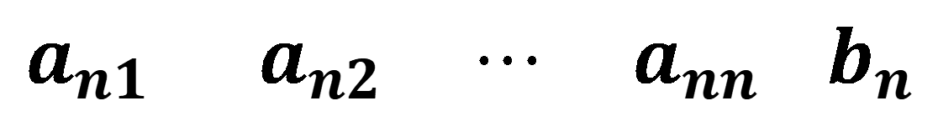
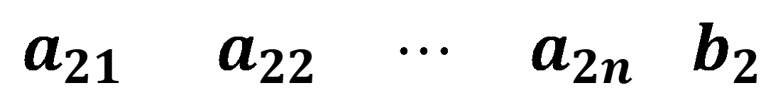
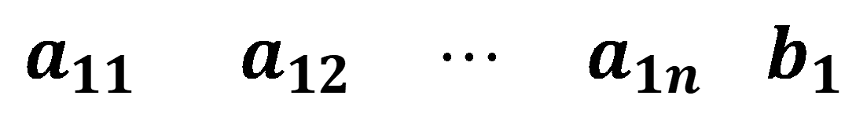
$$a_{11}{ a}_{12} ⋯ a_{1n }b_{1}$$
$$a_{21}{ a}_{22} ⋯ a_{2n }b_{2}$$
[A|b] =
$$⋮ ⋮ ⋱ ⋮ ⋮$$
$$a_{n1}{ a}_{n2} ⋯ a_{nn }b_{n}$$
Ax = b is inconsistent (i.e., no solution exists) if and only if rank [A] < rank [A|b] .
Ax = b has a unique solution if and only if rank [A] =rank [A|b] =n.
Ax = b has infnitely many solutions if and only if rank [A] =rank [A|b] <n.

Slide 10
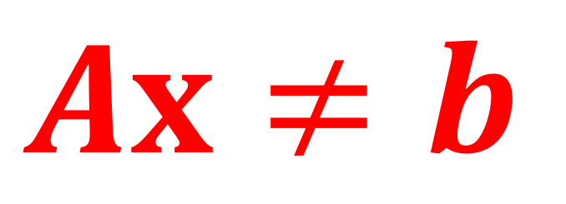
$$Ax≠b$$
The hardest quantities to compute are ones that do not exist.

Slide 11
Find the polynomial of order one for the data points (1, 2), (-1, 1) and (1, 3).
Next-Best: we want to find the x_{i}’s that make the residuals as small as possible. What do we mean by “small” ?
Least squares: Minimize the sum of the squares of the residuals
$$arg min r≜{r_{ 1}}^{2}+{r_{ 2 }}^{2}+{r_{ 3}}^{2}=(x_{ 1}+x_{ 2 }−2)^{2}+(x_{ 1}−x_{ 2}−1)^{2}+(x_{ 1}+x_{ 2}−3)^{2}$$

Slide 12
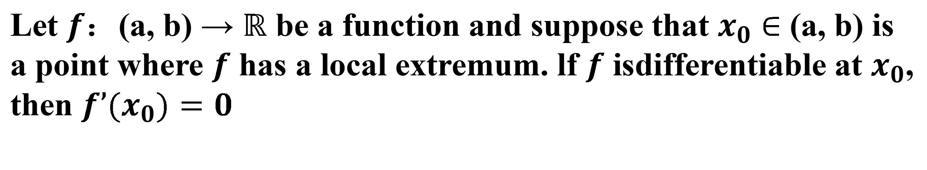
Fermat's theorem (also known as interior extremum theorem)
One way to state Fermat's theorem is that, if a function has a local extremum at some point and is differentiable therethen the function's derivative at that point must be zero. in precise mathematical language：
Let $f$：(a, b) → $ℝ$ be a function and suppose that $x_{0}$ $∈$ (a, b) is a point where $f$ has a local extremum. lf $f$ isdifferentiable at $x_{0}$, then $f’(x_{0})=0$

Slide 13
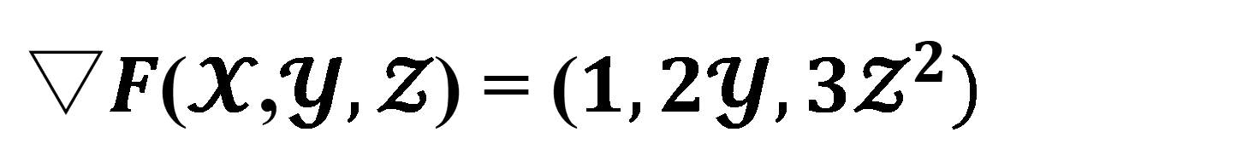
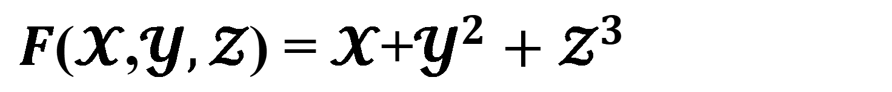
The gradient is a generalization of derivative of a function in one dimension to a function in several dimensions. The gradient is the vector whose components are the partial derivatives of f.
$F$($𝓧$,$𝓨,𝓩$) =$𝓧$+$𝓨^{2}+𝓩^{3}$
$▽F$($𝓧$,$𝓨,𝓩$) = ($1,2𝓨,{3𝓩}^{2})$

Slide 14
The extremum i.e., maximum or minimum of univariate (multivariate) function can be found at critical points, where the derivative (gradient, i.e., the derivatives for each variable of the function) of the objective function is zero.

Slide 15
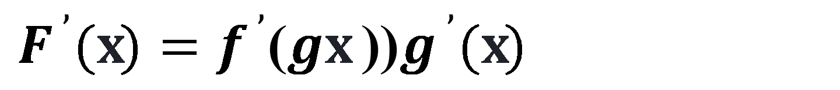
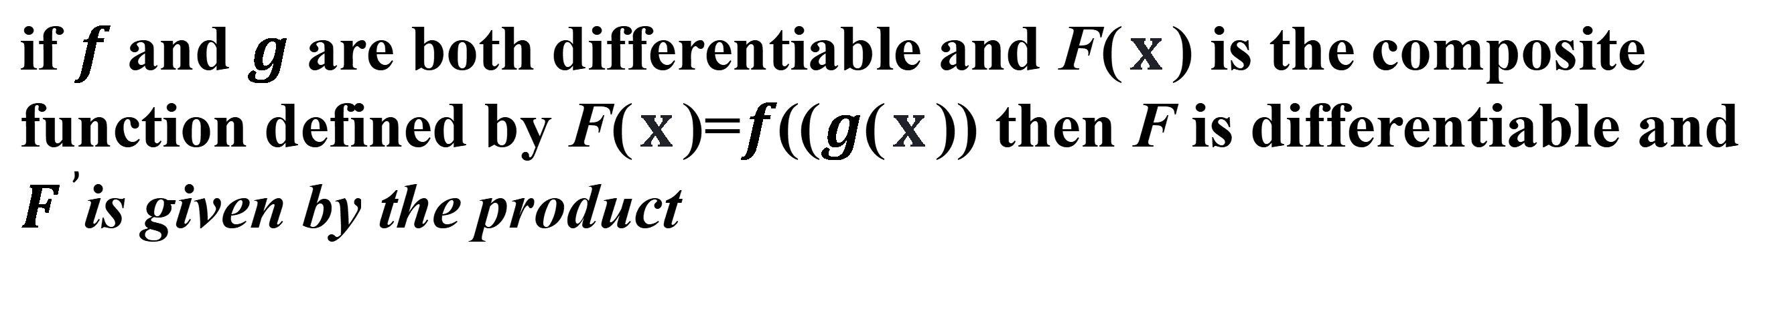
if $f$ and $g$ are both differentiable and F($x$ ) is the composite function defined by F($x$ )=$f$(($g$($x$ )) then F is differentiable and $F^{ ’}$is given by the product
$F^{ ’}(x)=f^{ ’}$($gx$ ))$g^{ ’}(x)$
Difierentiate outer function
Differentiate inner function
$f^{ ’}(x)=((x^{ 2}−1{)^{ 2})}^{ ’}={2(x}^{ 2}−1){(x}^{ 2}−1)^{ ’}={2(x}^{ 2}−1)$2$x$
keep the inside
take derivative of outside
multiply by derivative of the inside
Notes:
1

Slide 16
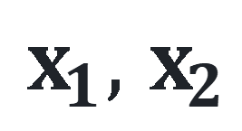
$$arg min f(x_{ 1}+x_{ 2})≜{r_{1}}^{2}+{r_{ 2}}^{2}+{{r }_{3}}^{2}$$
$=({x }_{1}+x_{ 2}−2)^{2}+(x_{ 1}−x_{ 2 }−1)^{2}+(x_{ 1}+x_{ 2}−3)^{2}$
$$x_{1} , x_{2}$$
$$\frac{∂f}{{∂x}_{ 1}}=2(x_{1}+x_{ 2}−2)+2(x_{1}−x_{ 2}−1)+2(x_{1}+x_{ 2}−3)=0$$
$$\frac{∂f}{{∂x}_{ 2}}=2(x_{1}+x_{ 2}−2)−2(x_{1}−x_{ 2}−1)+2(x_{1}+x_{ 2}−3)=0$$

Slide 17
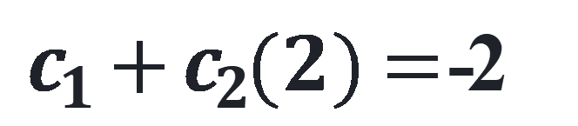
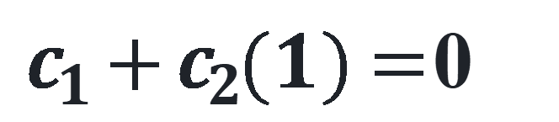
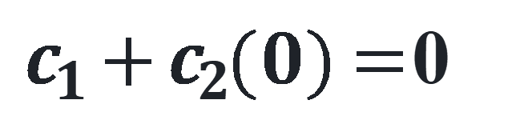
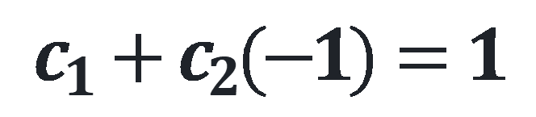
Example: Find the best line and best parabola for the four data points (−1,1), (0,0), (1,0) and (2,−2).
(1) Choose the model y=c₁+c₂t .
(2) Forcing the model to fit the data yields
$$c_{1}+c_{2}(−1)=1$$
$c_{1}+c_{2}( 0 )=$ 0
$c_{1}+c_{2}( 1 )=$ 0
$c_{1}+c_{2}( 2 )=$ -2
Solving for the coefficients c₁ and c₂ results in the best line y = c₁ + c₂t = 0.2 − 0.9t .

Slide 18

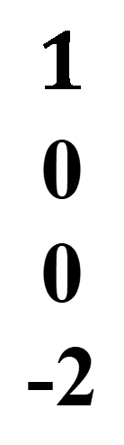



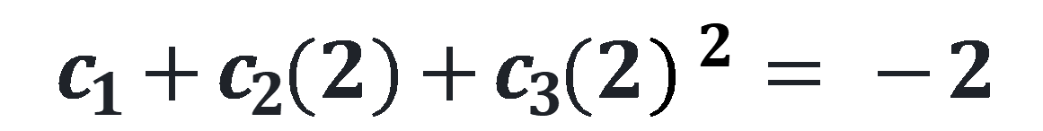
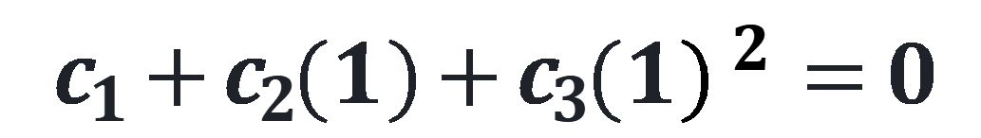
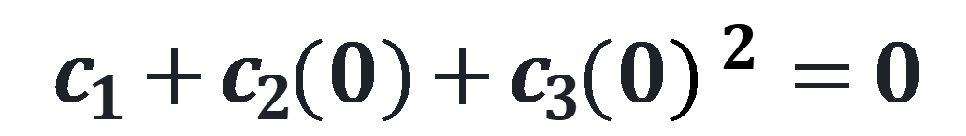
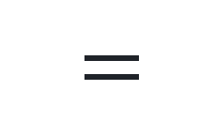
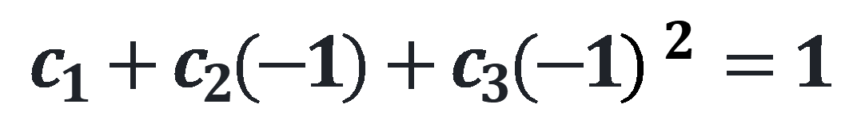
Next we extend this example by keeping the same four data points, but changing the model. Set y = c₁ + c₂t + c₃t² and substitute the data points to yield
$$c_{1}+c_{2}(−1)+c_{3}(−1)^{ 2}=1$$
$$c_{1}+c_{2}( 0 )+c_{3}( 0 )^{ 2}=0$$
$$c_{1}+c_{2}( 1 )+c_{3}( 1 )^{ 2}=0$$
$$c_{1}+c_{2}( 2 )+c_{3}( 2 )^{ 2}= −2$$
$$1$$
1
1
1
-$1$
0
1
2
$$1$$
0
1
4
$$1$$
0
0
-2
$$c_{1}$$
$$c_{2}$$
$$c_{3}$$
$$=$$

Slide 19
Please recheck \ (backslash) !
[1 1;1 -1;1 1] \ [2;1;3]
https://ww2.mathworks.cn/help/matlab/ref/mldivide.html

Slide 20
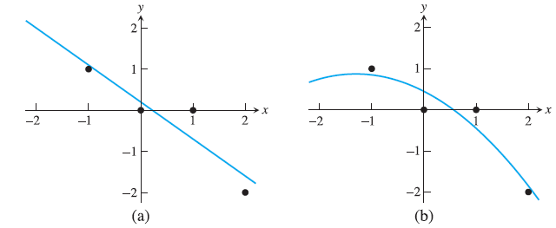
Solving for the coefficients results in the best parabola
y= c₁ + c₂t + c₃t ² = 0.45 − 0.65t − 0.25t ².

Slide 21

Summary
similarities and differences between interploation and least squares
find the law behind the data
exactly satisfy the conditions or not exactly satisfy the conditions

Slide 22
Examine the data visually
curve sketching is one way or...
best: use a MATLAB plot to get the
lay of the land
Guess the rule and validate the rule

Slide 23
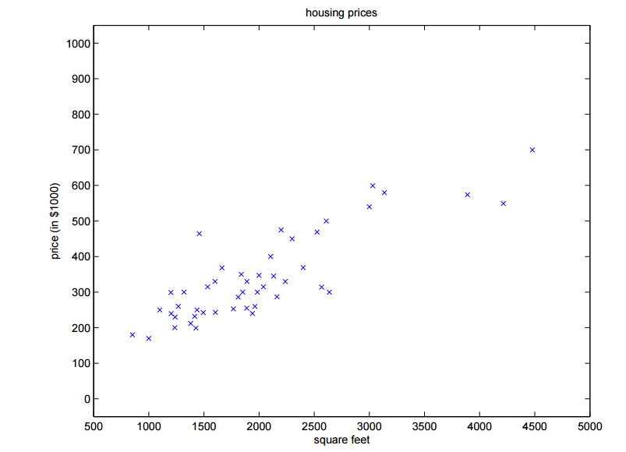
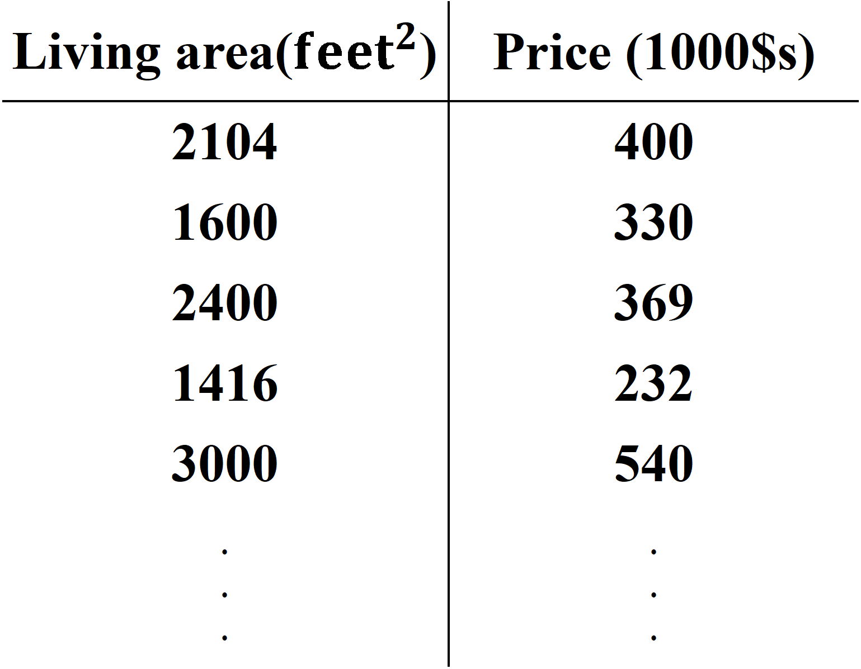
Example : Suppose we have a dataset giving the living areas and prices of 47 houses from Portland, Oregon :
Living area(${feet}^{2}$) | Price (1000$s)
2104 | 400
1600 | 330
2400 | 369
1416 | 232
3000 | 540
· · · | · · ·

Slide 24

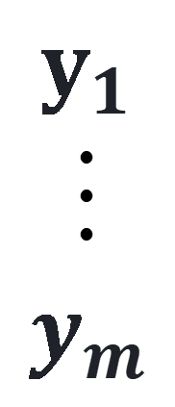

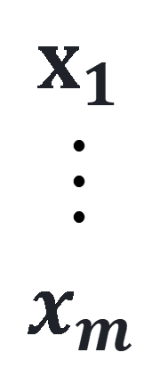




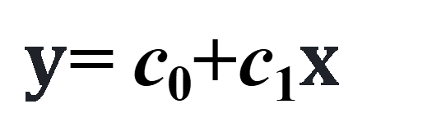
The fitting function is:
$y$= c₀+c₁$x$
$$c_{0}+c_{1}x_{1}=y_{1}$$
1
·
·
·
1
$$x_{1}$$
·
·
·
$$x_{m}$$
$$c_{0}$$
·
·
·
$$c_{1}$$
$$y_{1}$$
·
·
·
$$y_{m}$$
$$c_{0}+c_{1}x_{2}=y_{2}$$
$$=$$
$$········$$
$$c_{0}+c_{1}x_{m}=y_{m}$$

Slide 25
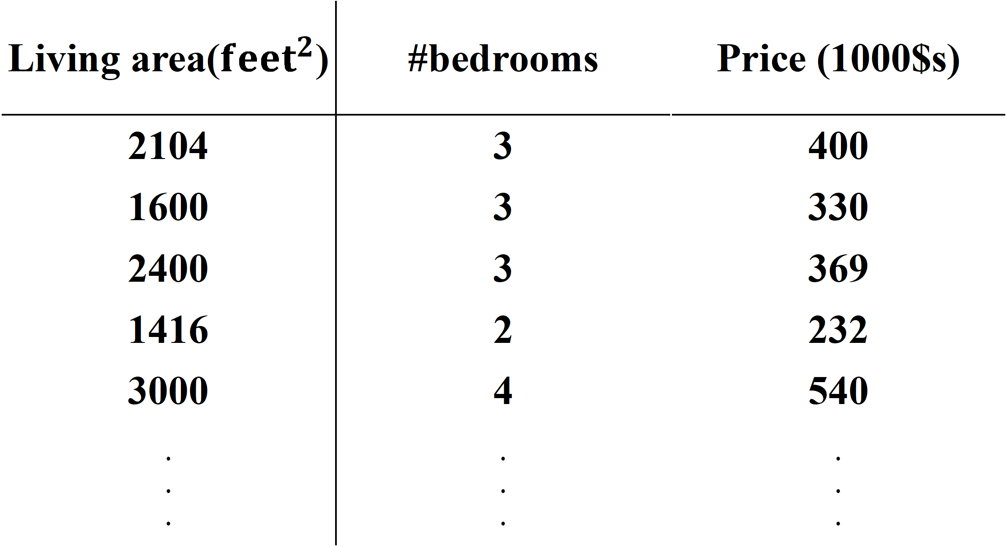
Living area(${feet}^{2}$) | #bedrooms | Price (1000$s)
2104 | 3 | 400
1600 | 3 | 330
2400 | 3 | 369
1416 | 2 | 232
3000 | 4 | 540
· · · | · · · | · · ·

Slide 26
x = 1:50;
y = -0.3*x + 2*randn(1,50);
p = polyfit(x,y,1);
% Evaluate the fitted polynomial p and plot:
f = polyval(p,x);
plot(x,y,'o',x,f,'-')
legend('data','linear fit')

Slide 27
Predict the population of American in 2030
Year | 1900 | 1910 | 1920 | 1930 | 1940 | 1950
Population | 75.995 | 91.972 | 105.711 | 123.203 | 131.669 | 150.697
Year | 1960 | 1970 | 1980 | 1990 | 2000 | 2010
Population | 179.323 | 203.212 | 226.505 | 249.633 | 281.422 | 308.746
load census, plot(x,y, 'o')
P = polyfit(x,y,3);
polyval(P,2020) %validating data 2020（331.45）

Slide 28
CPU | year | transistors
4004 | 1971 | 2,250
8008 | 1972 | 2,500
8080 | 1974 | 5,000
8086 | 1978 | 29,000
286 | 1982 | 120,000
386 | 1985 | 275,000
486 | 1989 | 1,180,000
Pentium | 1993 | 3,100,000
Pentium II | 1997 | 7,500,000
Pentium III | 1999 | 24,000,000
Pentium 4 | 2000 | 42,000,000
Itanium | 2002 | 220,000,000
Itanium 2 | 2003 | 410,000,000
The number of transistors on Intel central processing units since the early 1970s is given in the following table.

Slide 29
xdata=[1 2 4 8 12 15 19 23 27 29 30 32 33];
ydata=[2250 2500 5000 29000 120000 275000 1180000 3100000 7500000 24000000 42000000 220000000 410000000];
plot(xdata,ydata,'o')
Exponential law
Fit the model ${y=c_{1}e}^{c_{2}t}$ to the data.

Slide 30
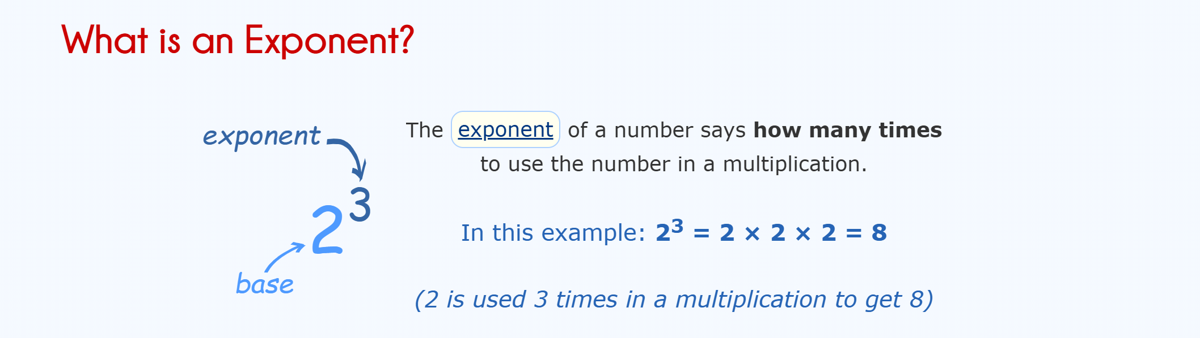

Slide 31
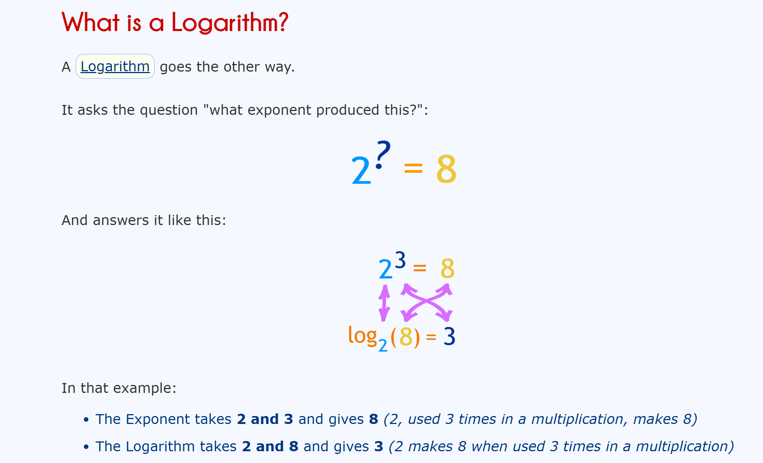

Slide 32


Slide 33
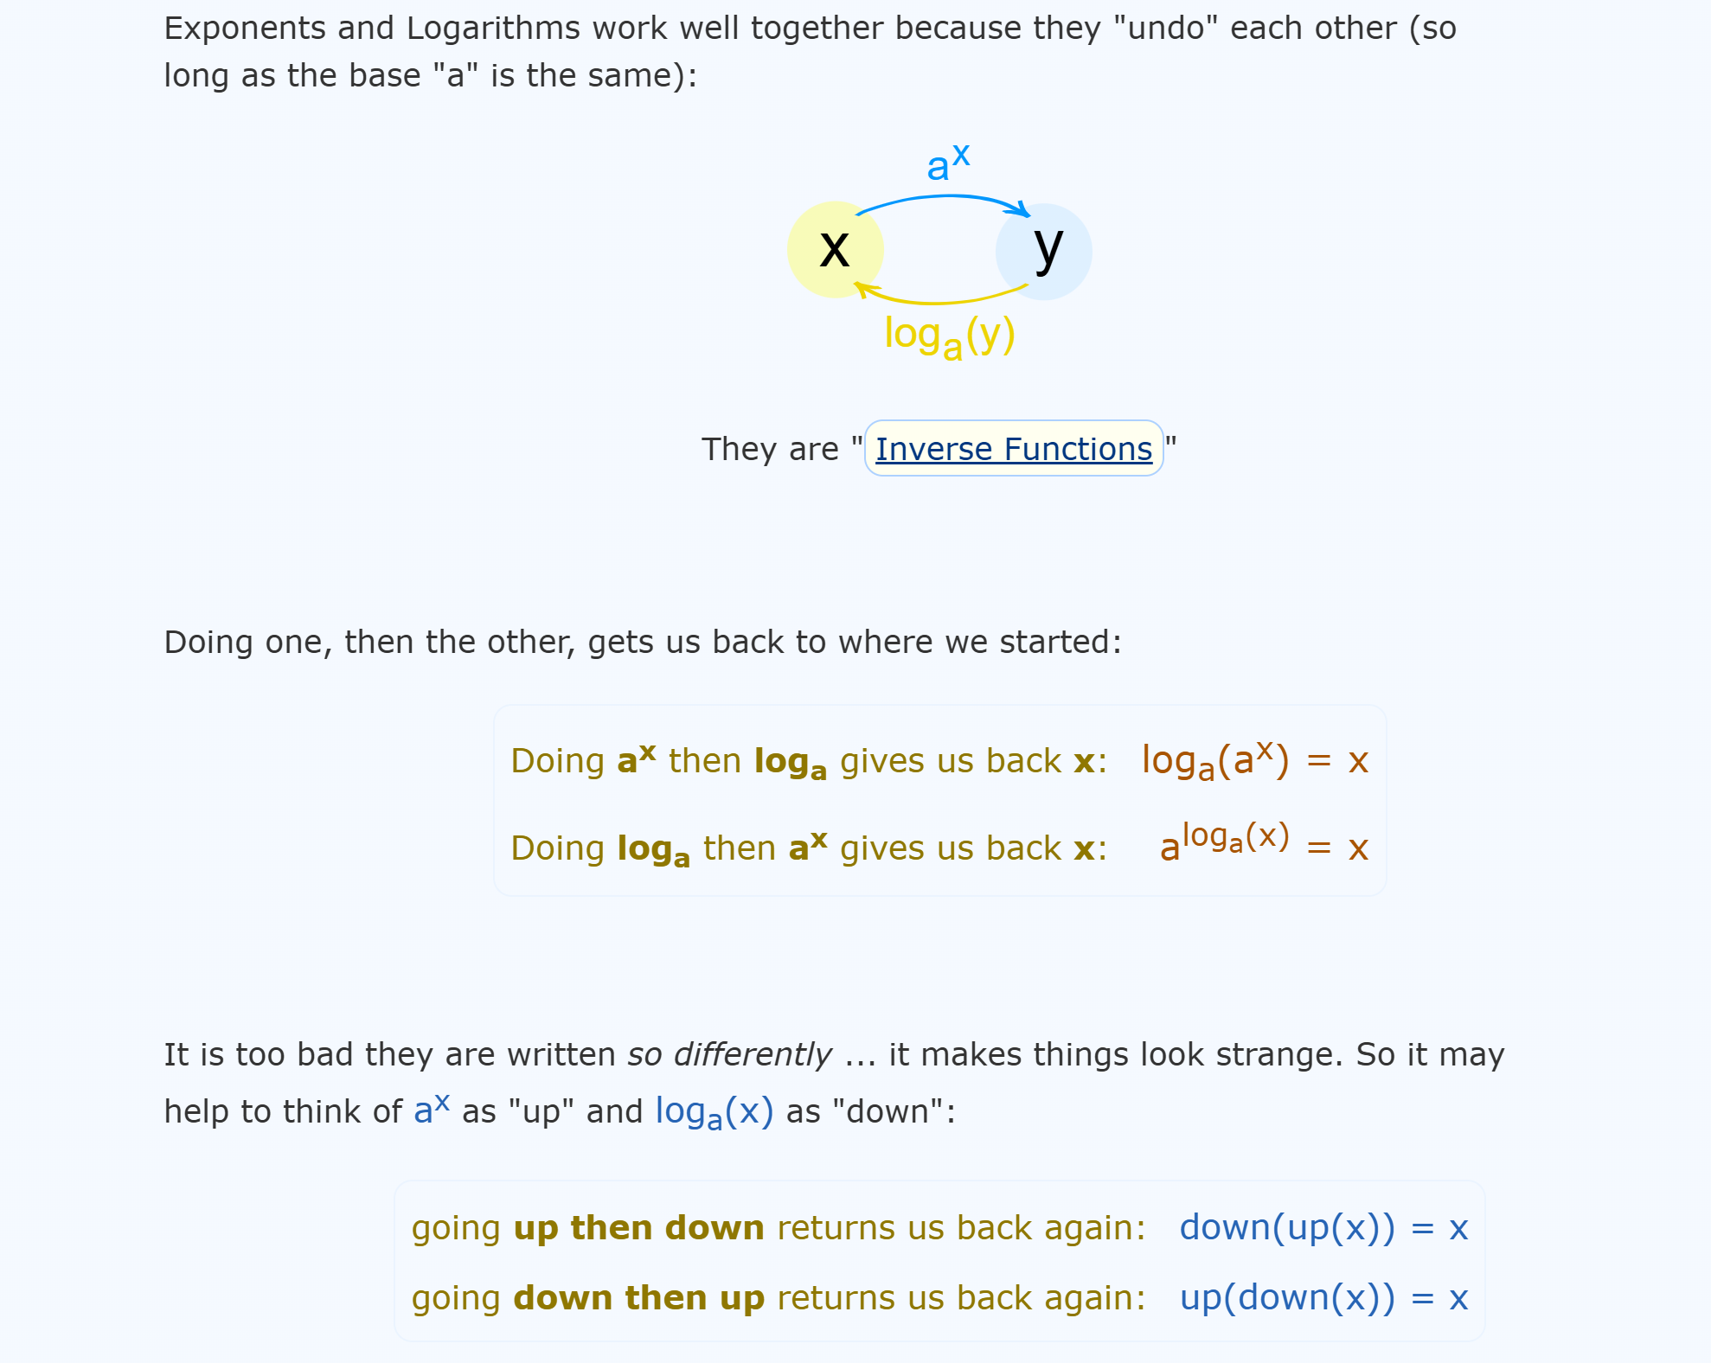

Slide 34
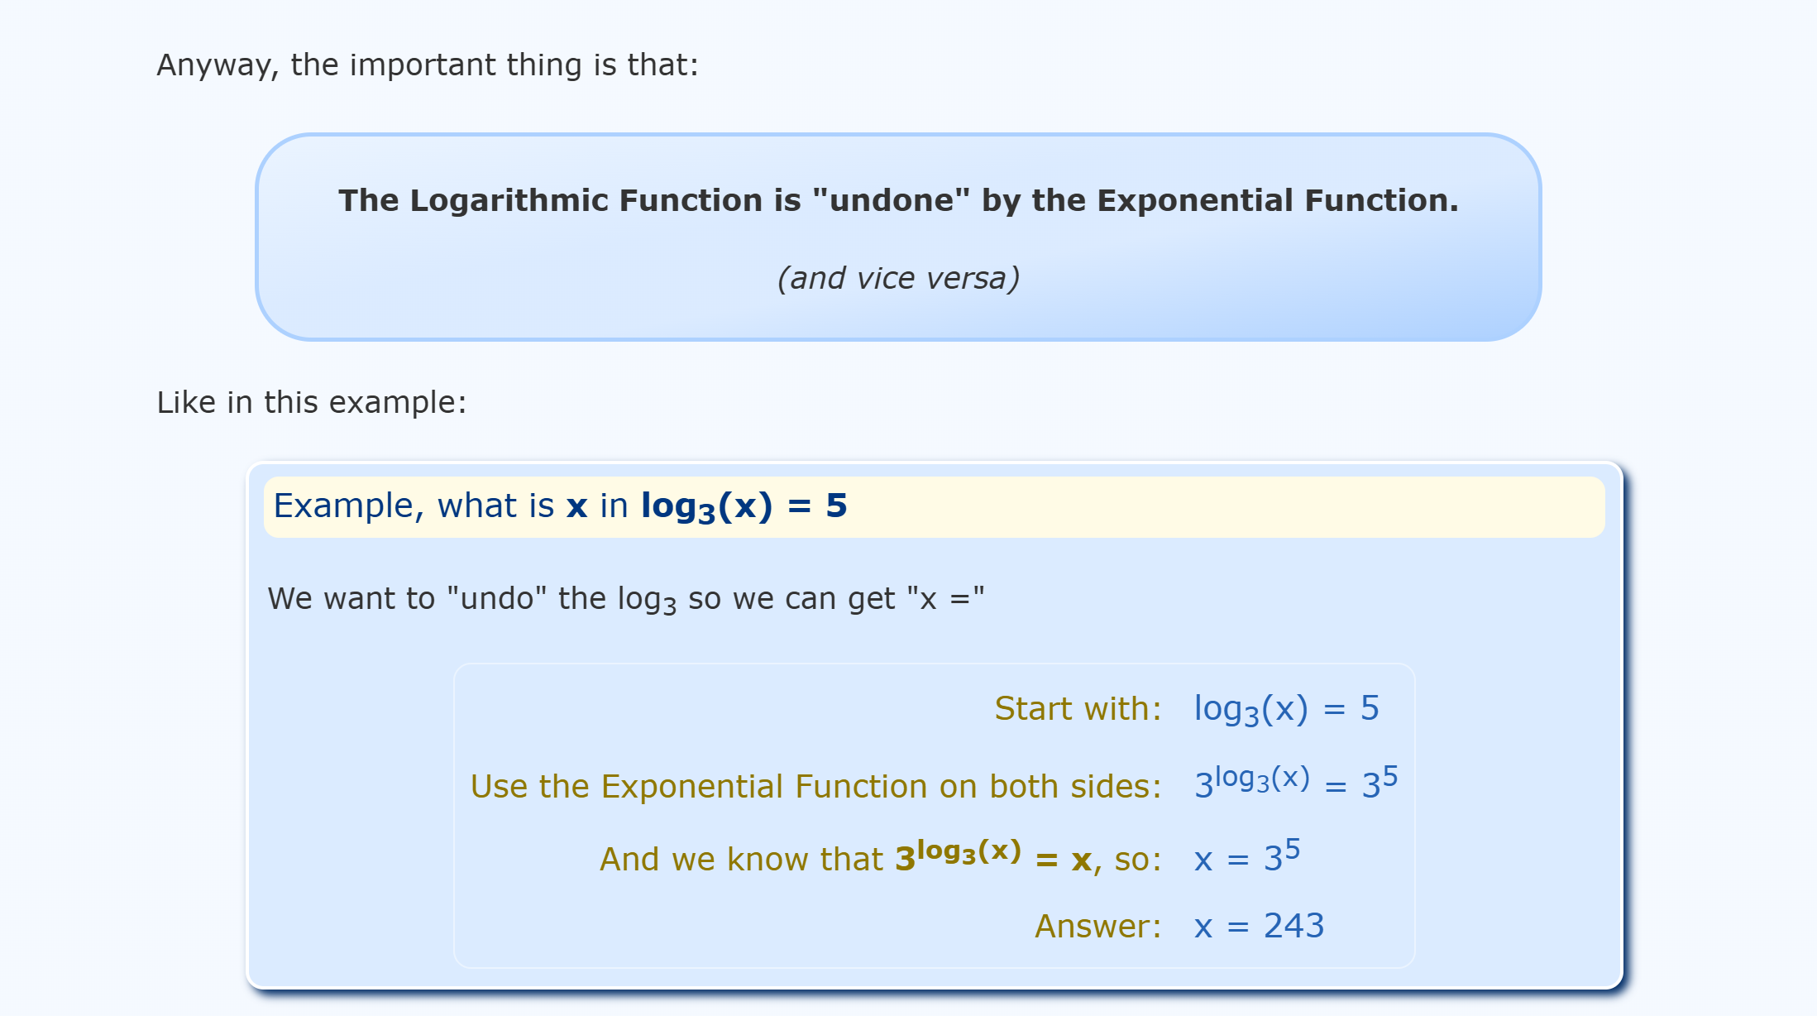

Slide 35
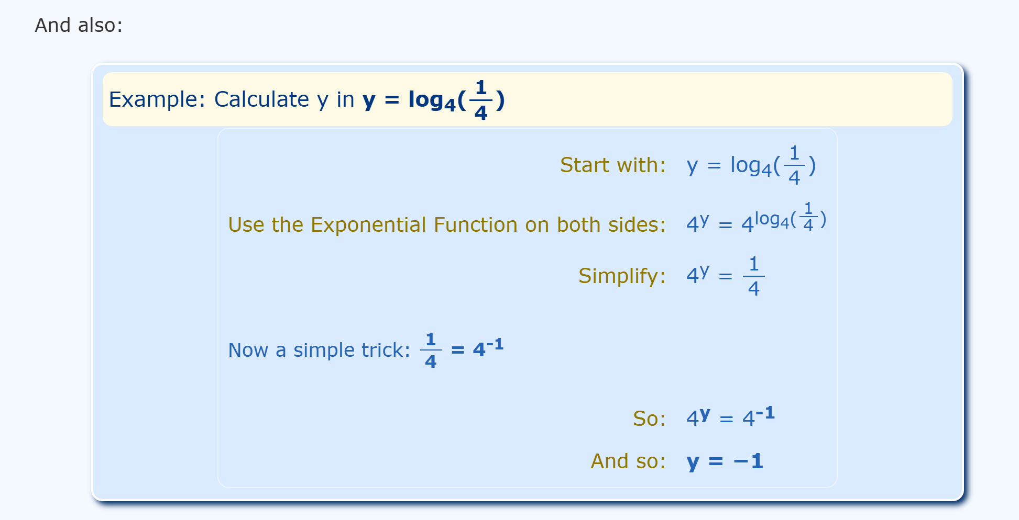

Slide 36
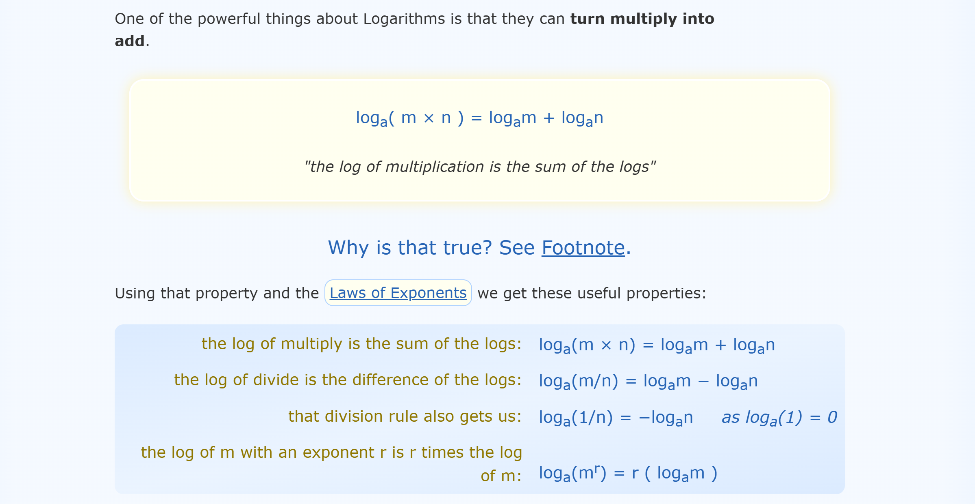

Slide 37
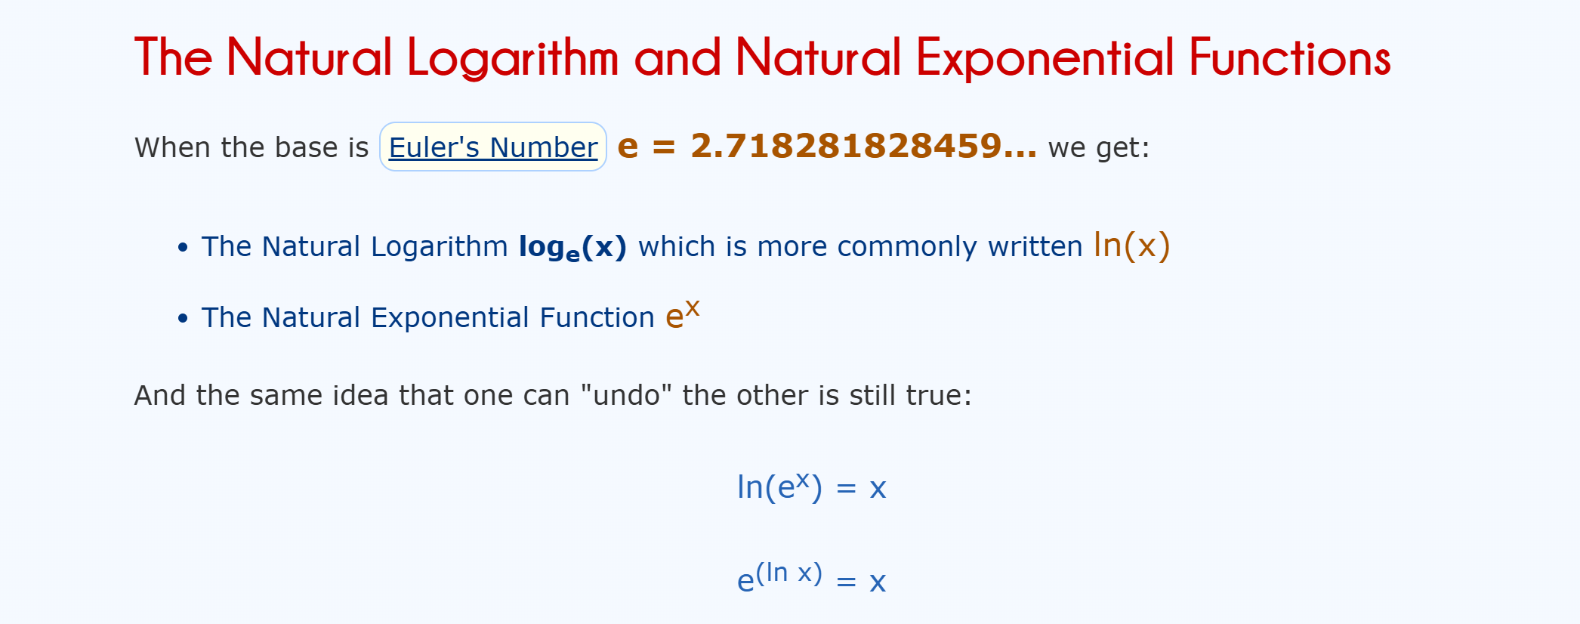

Slide 38




Parameters will be fit by using model linearization. Linearizing the model gives lny = k + c₂t.
Substituting the data into the linearized model yields
$$k+c_{2}( 1 )=ln 2250$$
$$k+c_{2}( 2)=ln 2500$$
$$k+c_{2}( 4)=ln 5000$$
$$k+c_{2}( 8)=ln 29000$$
The matrix equation is Ax = b, where x = (k, c₂).

Slide 39
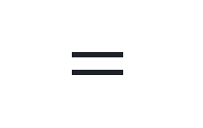
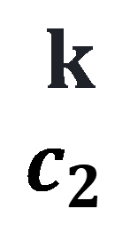

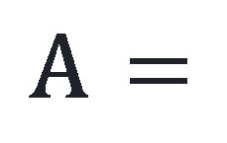

$$1$$
1
1
1
·
·
·
1
1
2
4
8
·
·
·
33
ln2250
ln2500
ln5000
ln29000
·
·
·
ln410000000
A $=$
b $=$
The normal equations are
13
235
235
5927
$$k$$
$$c_{2}$$
176.90
3793.23
$=$
which has solution k ≈ 7.197 and c₂ ≈ 0.3546, leading to c₁= e^{k} ≈ 1335.3 . The fitting function is y = 1335.3e ^{0.3546t} .

Slide 40
Curve Fitting Toolbox (cftools)

Slide 41
CPU | year | transistors
4004 | 1971 | 2,250
8008 | 1972 | 2,500
8080 | 1974 | 5,000
8086 | 1978 | 29,000
286 | 1982 | 120,000
386 | 1985 | 275,000
486 | 1989 | 1,180,000
Pentium | 1993 | 3,100,000
Pentium II | 1997 | 7,500,000
Pentium III | 1999 | 24,000,000
Pentium 4 | 2000 | 42,000,000
Itanium | 2002 | 220,000,000
Itanium 2 | 2003 | 410,000,000

Slide 42
xdata=[1 2 4 8 12 15 19 23 27 29 30 32 33];
ydata=[2250 2500 5000 29000 120000 275000 1180000 3100000 7500000 24000000 42000000 220000000 410000000];
cftools

Slide 43
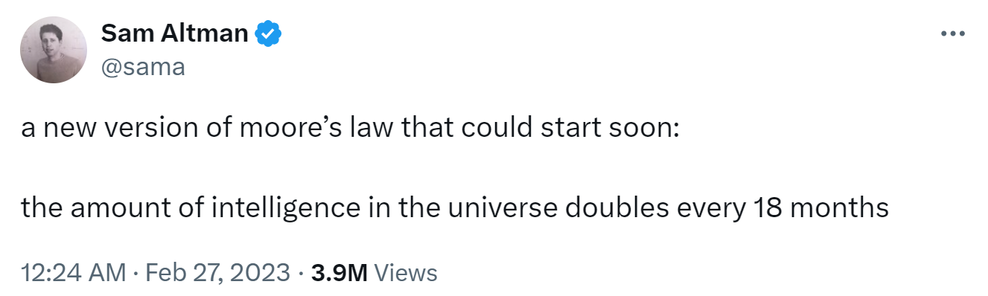

Slide 44
Power Law
These are two very different ways of viewing the world, with some events following a Gaussian distribution (e.g., the heights of individual human beings) and other events following a Power distribution (e.g., the wealth of individual human beings).
https://en.wikipedia.org/wiki/Power_law
https://en.wikipedia.org/wiki/Kleiber%27s_law Kleiber's law(an animal's metabolic rate scales to the ¾ power of the animal's mass.)

Slide 45
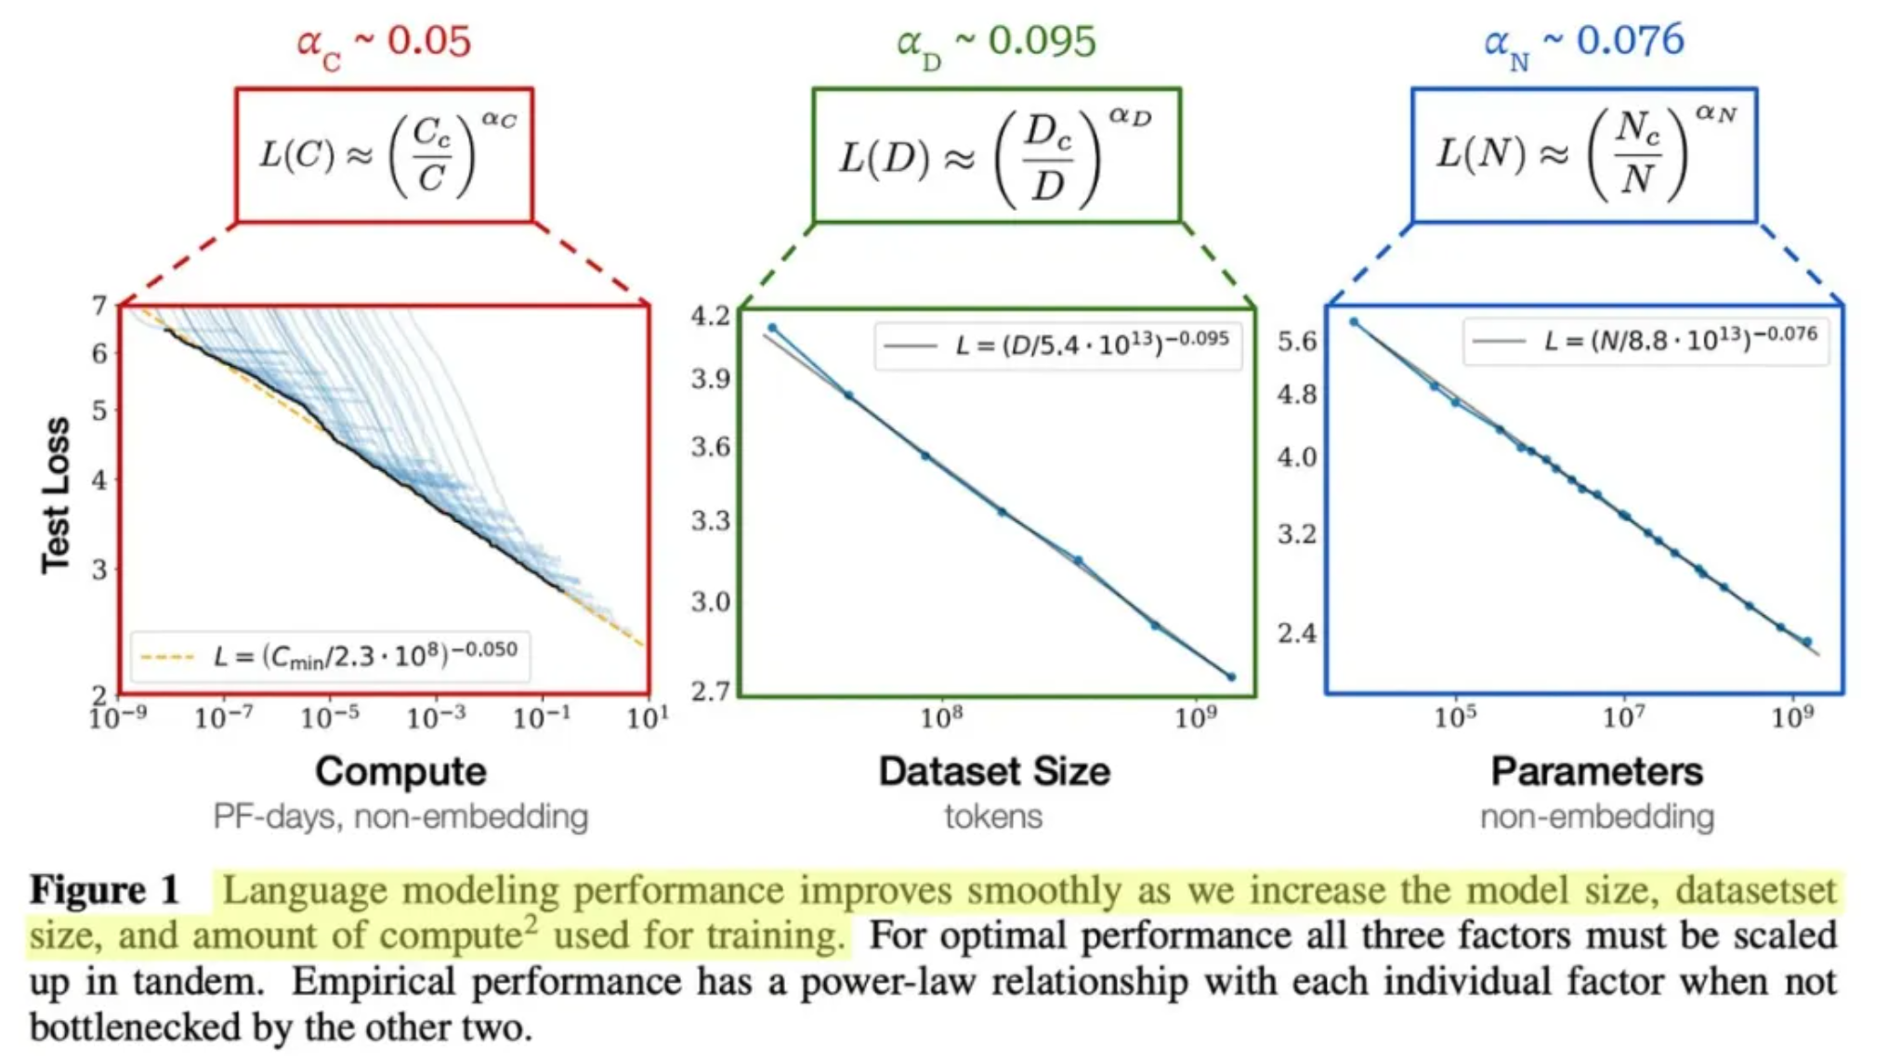
Power Law
Fit the model y = c(x)^{α} to the data.
https://mp.weixin.qq.com/s/-_gFm3mdvxUj5YKZZSfa3A

Slide 46
Summary
similarities and differences between interploation and least squares
find the law behind the data
satisfy the conditions or not satisfy the conditions

Slide 47

How to select the best model?

Slide 48
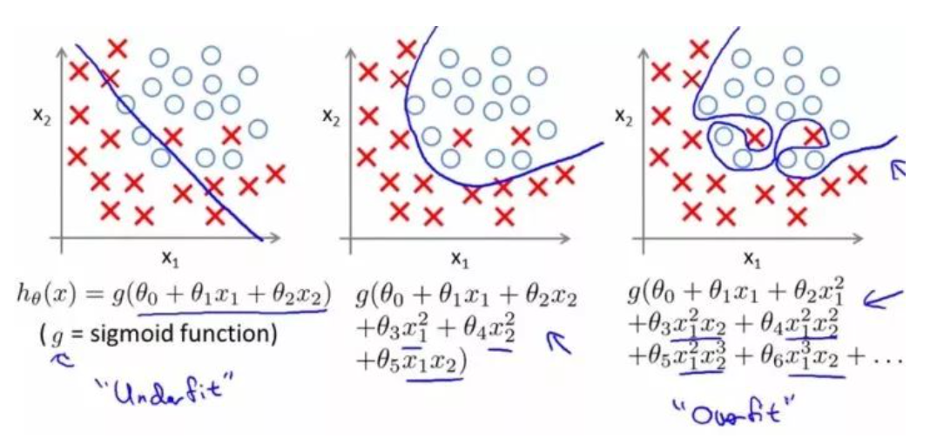
Occam’s razor, also called law of economy or law of parsimony.
The principle gives precedence to simplicity: of two competing theories, the simpler explanation of an entity is to be preferred. The principle is also expressed as “Entities are not to be multiplied beyond necessity.”

Slide 49



training data testing data
Notes:
sawtooth

Slide 50
Revisit of the laws of planetary motion
(0+4)/10=0.4 (Mercury)；
(3*1+4)/10=0.7 (Venus)；
(3*2+4)/10=1.0；
(3*2²+4)/10=1.6 (Mars)；
(3*2³+4)/10=2.8 (?)；
(3*2⁴+4)/10=5.2 (Jupiter)；
(3*2⁵+4)/10=10 (Saturn)；
Titius-Bode Law (3*2^{ⁿ}+4)/10？

Slide 51
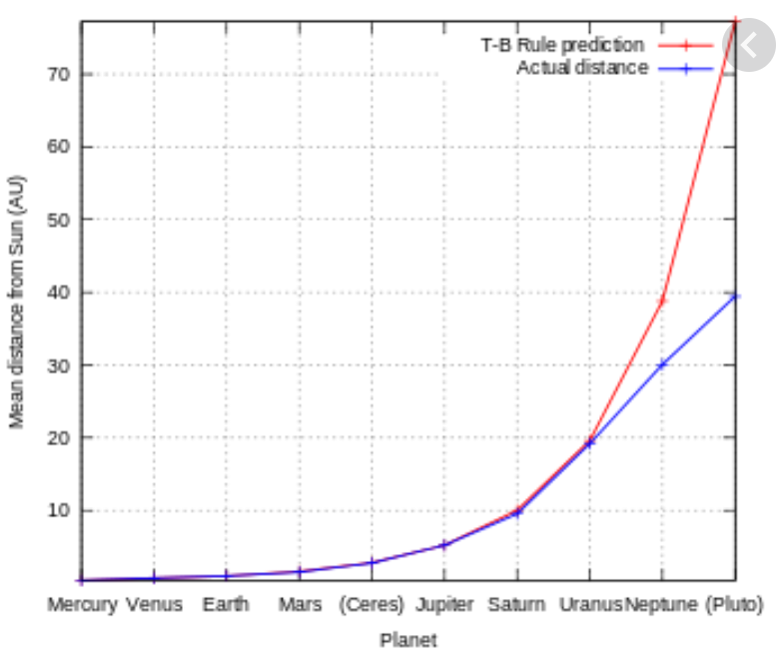
The semi-major axis of each planet outward from the Sun in units such that the Earth's semi-major axis is 1.
(3*2^{ⁿ}+4)/10？
The law correctly anticipated the orbits of Uranus and Ceres, but failed as a predictor of Neptune's orbit and was eventually superseded as a theory of Solar System formation.

Slide 52
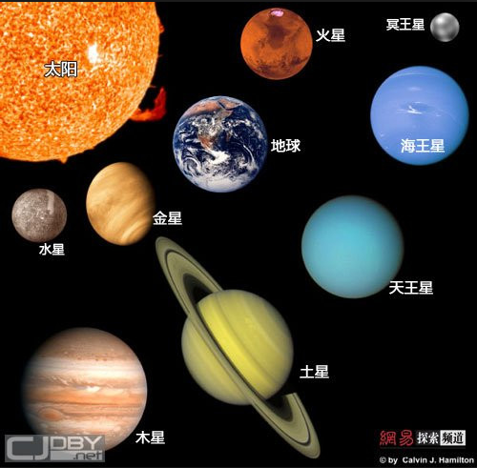
Law of planet

Slide 53
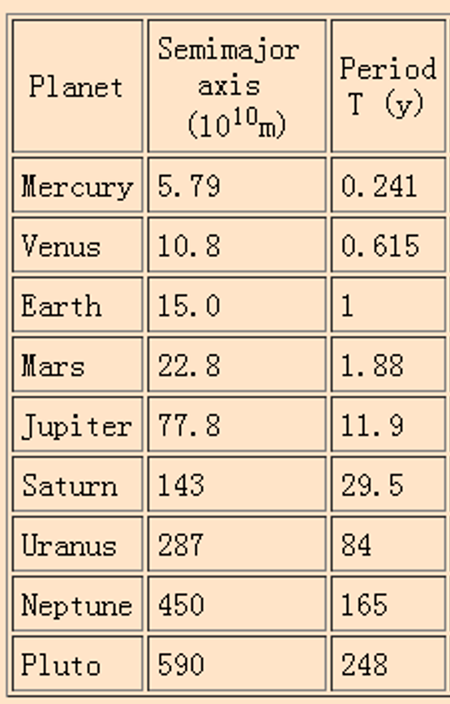
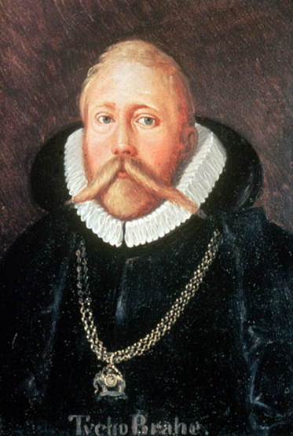
Tycho collect the data of
planetary motion

Slide 54
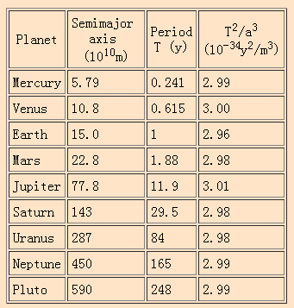
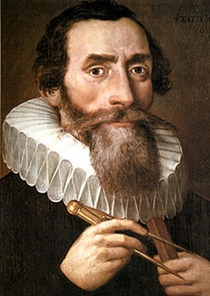
Kepler find the laws of
planetary motion
The ratio of the square of an object's orbital period with the cube of the semi-major axis of its orbit is the same for all objects orbiting the same primary.

Slide 55
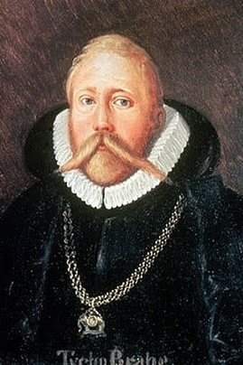

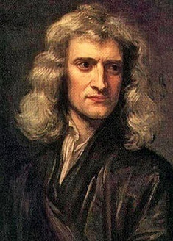
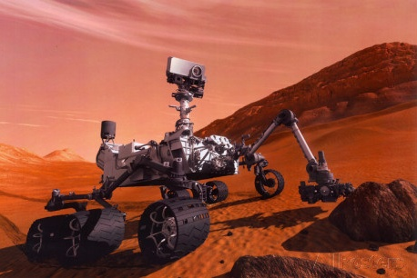
Rethink of the laws of planetary motion
Identifying phenomenon (Tycho Brahe)
Describing phenomena (Johannes Kepler)
Discussing mechanisms (Isaac Newton)
Applying mechanisms (exploration of space)

Slide 56

Why Ice Cream Isn't Deadly: Correlation vs. Causation

Slide 57
Understanding the difference between correlation and causation.
Let me present you with a shocking fact: When ice cream sales increase, so do homicide rates.
Before we start banning the sale of ice cream to prevent the loss of innocent lives, let’s define both correlation and causation. Correlation is a mutual relationship or connection between two or more things. Causation, on the other hand, is the action of causing something. In short, the difference is that two things can be correlated, but that doesn’t mean that one thing caused the other.
Going back to the ice cream example, it’s true that ice cream sales and murder rates are positively correlated. However, ice cream doesn’t cause murder. It turns out, both ice cream sales and increased homicide rates have a third variable in common: heat. When heat rises, ice cream sales increase. Unrelated to the ice cream, heat also causes murder rates to increase.

Slide 58
The main takeaway boils down to one sentence: correlation is not causation. While it might be easy to remember that when someone tells you that ice cream and homicide have been statistically linked, it becomes trickier when the claim is less outrageous. Maybe a friend tells you that they read an article saying people who eat kale live statistically longer. You want to live longer, so you start eating lots of kale. After all, eating kale will give you a few extra years, right? While those kale salads probably aren’t bad for you, you’ve forgotten that correlation isn’t causation. I think it’s significantly more likely that people who eat kale are more concerned with health and wellness, and therefore live a bit longer, than kale alone being responsible for a longer life.
Discard that kale salad and go buy yourself some ice cream, because correlation is not causation.

Slide 59

Sora paradox

Slide 60

Sora paradox

